Slide 1
GCP Experience

Slide 2
Some principles
If we want to have an efficient and cost effective process to run applications
Need a good development environment
Need a good infrastructure
Resiliency
Updates with no downtime
Support Canary, Blue/Green deployments
Not to mention a DevOps culture in place

Slide 3
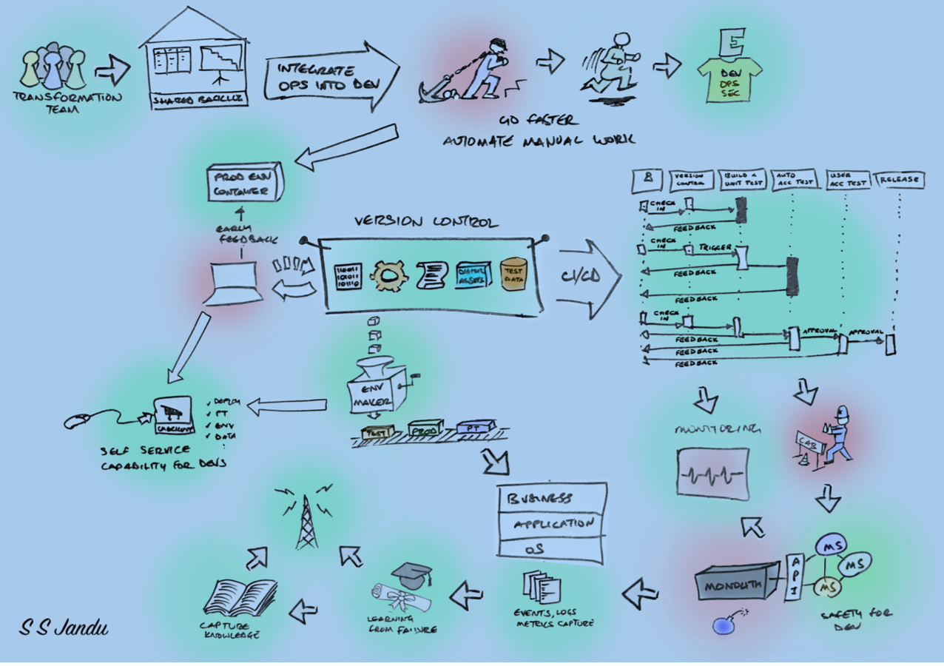
A possible “desired” model
Jules?
DEV

Slide 4
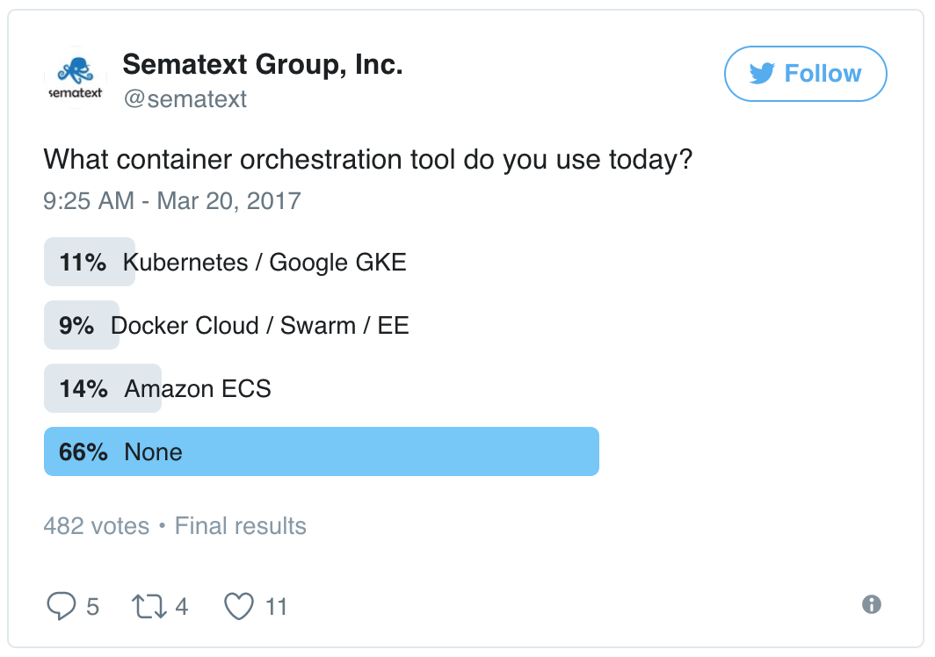
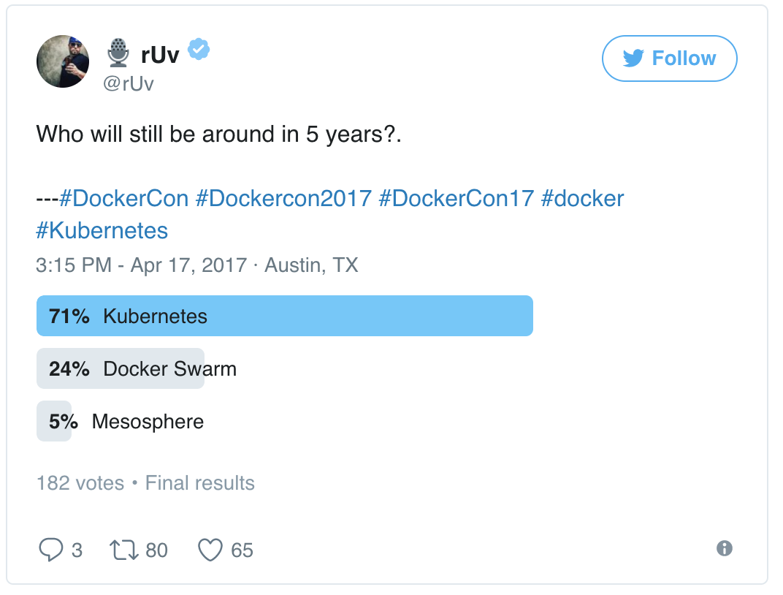
Trends on orchestration (to keep in mind)
https://sematext.com/blog/2017/04/24/docker-orchestration-poll-kubernetes-swarm-amazon-ecs/

Slide 5
My GCP journey
Started as a “simple” user – manual onboarding
Got permission to create services (Basilica)
Could not use the services created: no GUI available
Work with Ravi to get Spark to run
No HDFS local or remote, all in memory
Could not get results or logs – no debugging capabilities
Cannot delete/update services
Created Kafka service (that was used later on)
Spark and Kafka are the OpeSource versions, no authentication, no security

Slide 6
My GCP journey
Experiment with container
No or very limited access to DC-OS
Access via gcp-api
Latest version made available gcp-cli (more on this later)
How to build an image
AIM-PM tool (requested access and installed tool in windows system)
Not user friendly at all: Jitu provided me wit a working script that I adapted
Operation: after code developed, run scripts, check on another site to check for build status
Could not get ”pip” to run (module manager for python)
Worked with Mike Katkin (AIM)
Worked with Jeff who gave the “recipe” that worked
Worked with Jeff to resolve images not showing in QuayGCP GUI that had multipage build
Extremely difficult to develop anything of substance without proper access to a DEV environment
Got access to a lab machine where docker machine was installed
Transfer files via “python SimpleHTTPServer”
Back on GCP, was given permission to access logs (stdio, errors)

Slide 7
GCP: image build process
Dockerfile
<Code>
Script:
6 steps
Quay: Registry
Dockerfile
<Code>
Docker build
Docker push (optional)
GUI
Status
BuildLogs
GCP
Docker

Slide 8
GCP: container run process
curl
Postman
Post
Get
GUI
Get Logs/Output
Docker run
Marathon
json
Quay: Registry
GCP
Docker

Slide 9
Run containers
Experiment with container
No or very limited access to DC-OS API directly
Access via gcp-api
Could deploy image and run image with curl or postman
A new image name is created for any change in the code or Dockerfile
This new image needs to be reflected in marathon.json
Difficult to develop anything of substance without proper access to a DEV environment
From creating a image, deploying and getting results to many steps
Got access to a lab machine where docker was installed
Transfer files via “python SimpleHTTPServer”
Back on GCP, was given permission to access logs (stdio, errors)
Latest version provides gcp-cli for DEV
Simplifies the creation and deployment of images – better round trip
Access to output still through url – webpage with a common user, where you have to find your container
Still no “exec” capability to introspect the container

Slide 10
Using services from market place
Spark
Could only experiment with a trivial jar file
Output needs to be retrieved the same way as the container output
Soon to be able to connect to external HDFS and use pyspark
Kafka
Created a simple streaming application, one container producing and one consuming and presenting the stream on a web page.
Extended this application to demonstrate that a topic could be produced in GCP and consumed in GAP
This is being used in the Praestro project

Slide 11
Customer requests
Spark
Connection to external HDFS
Local HDFS
Expose pyspark capabilities (inherent to the tool)
Kafka
Authentication and security
Use of vendor/external images (ArangoDB, Neo4J, Informatica(?))
Need to define a process
Mount of external volumes
Looking at StorageOs as a candidate
File transfer

Slide 12
Conclusion
As of now
Need a better development experience
Need to have better clarity from JPMIS regarding marketplace
A good candidate for run vendor/external docker images
Should be “compatible” with Zeus in terms of user experience and capabilites
Need to figure out performance of this platform: network, computation, storage
Need to verify HA capabilities
Need to find a sweet spot for this platform

